Slide 1


Project Presentation
Presented by Parimi Gandhi Balaji

Slide 2
Let’s Get Started
Introduction
Objective & Scope Of the Project
Application Tools
Project Design
Flowchart
Testing And Validation
Conclusion
References

Slide 3
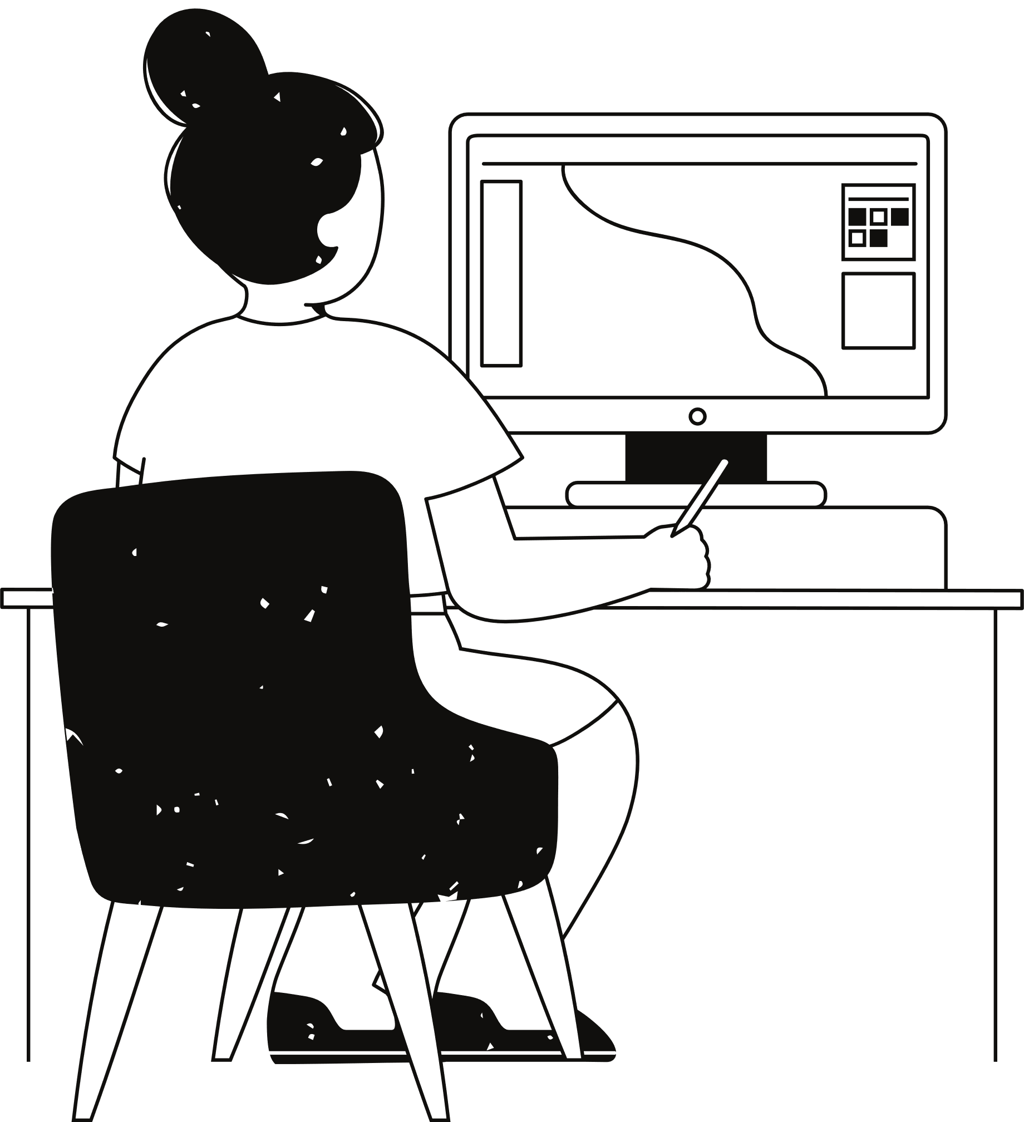
Introduction
My project is a GUI-based grocery store inventory and sales management system that allows store owners to manage their inventory and sales data easily. The application is built using the Python programming language and the Tkinter and Pandas libraries. It provides a user-friendly interface with labels and entry fields for adding, updating, and deleting product details such as name, price, and quantity.
The system also allows store owners to sell products and update sales data, as well as generate reports for inventory and sales. The reports can be saved to CSV files for future reference. The application aims to simplify the inventory and sales management process for grocery store owners, providing them with an efficient and effective tool to keep track of their store's operations.
.

Slide 4
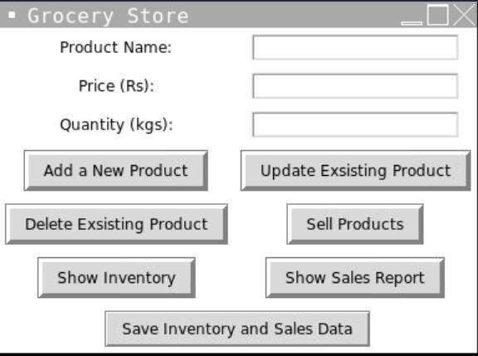
Objective Of the Project
Create a user-friendly graphical interface for managing a grocery store inventory and sales data using the Tkinter library.
Use the panda’s library to handle and manipulate inventory and sales data stored in CSV files.
Implement functions for adding, updating, and deleting products from the inventory.
Implement a function for selling products and updating sales data.
Develop a function for generating reports on inventory and sales data, which can be displayed to the user.
Provide functionality for saving changes made to the inventory and sales data to CSV files. Develop error handling and input validation to ensure the user is entering valid data and prevent crashes.
Test the system to ensure its functionality and identify and fix any bugs or issues. Optimize the system for performance and efficiency, so it can handle large amounts of data and users without slowing down or crashing.
Incorporate any additional features or requirements as requested by the grocery store.

Slide 5

Scope Of the Project
The scope of the project involves designing a user-friendly graphical user interface (GUI) that allows store managers to easily add, update, and delete products from their inventory, record sales data, and generate reports.
The system should be able to handle large amounts of data, perform calculations such as total sales, and display information in a clear and concise manner. Additionally, the system should have error-handling capabilities to prevent data loss or corruption.

Slide 6
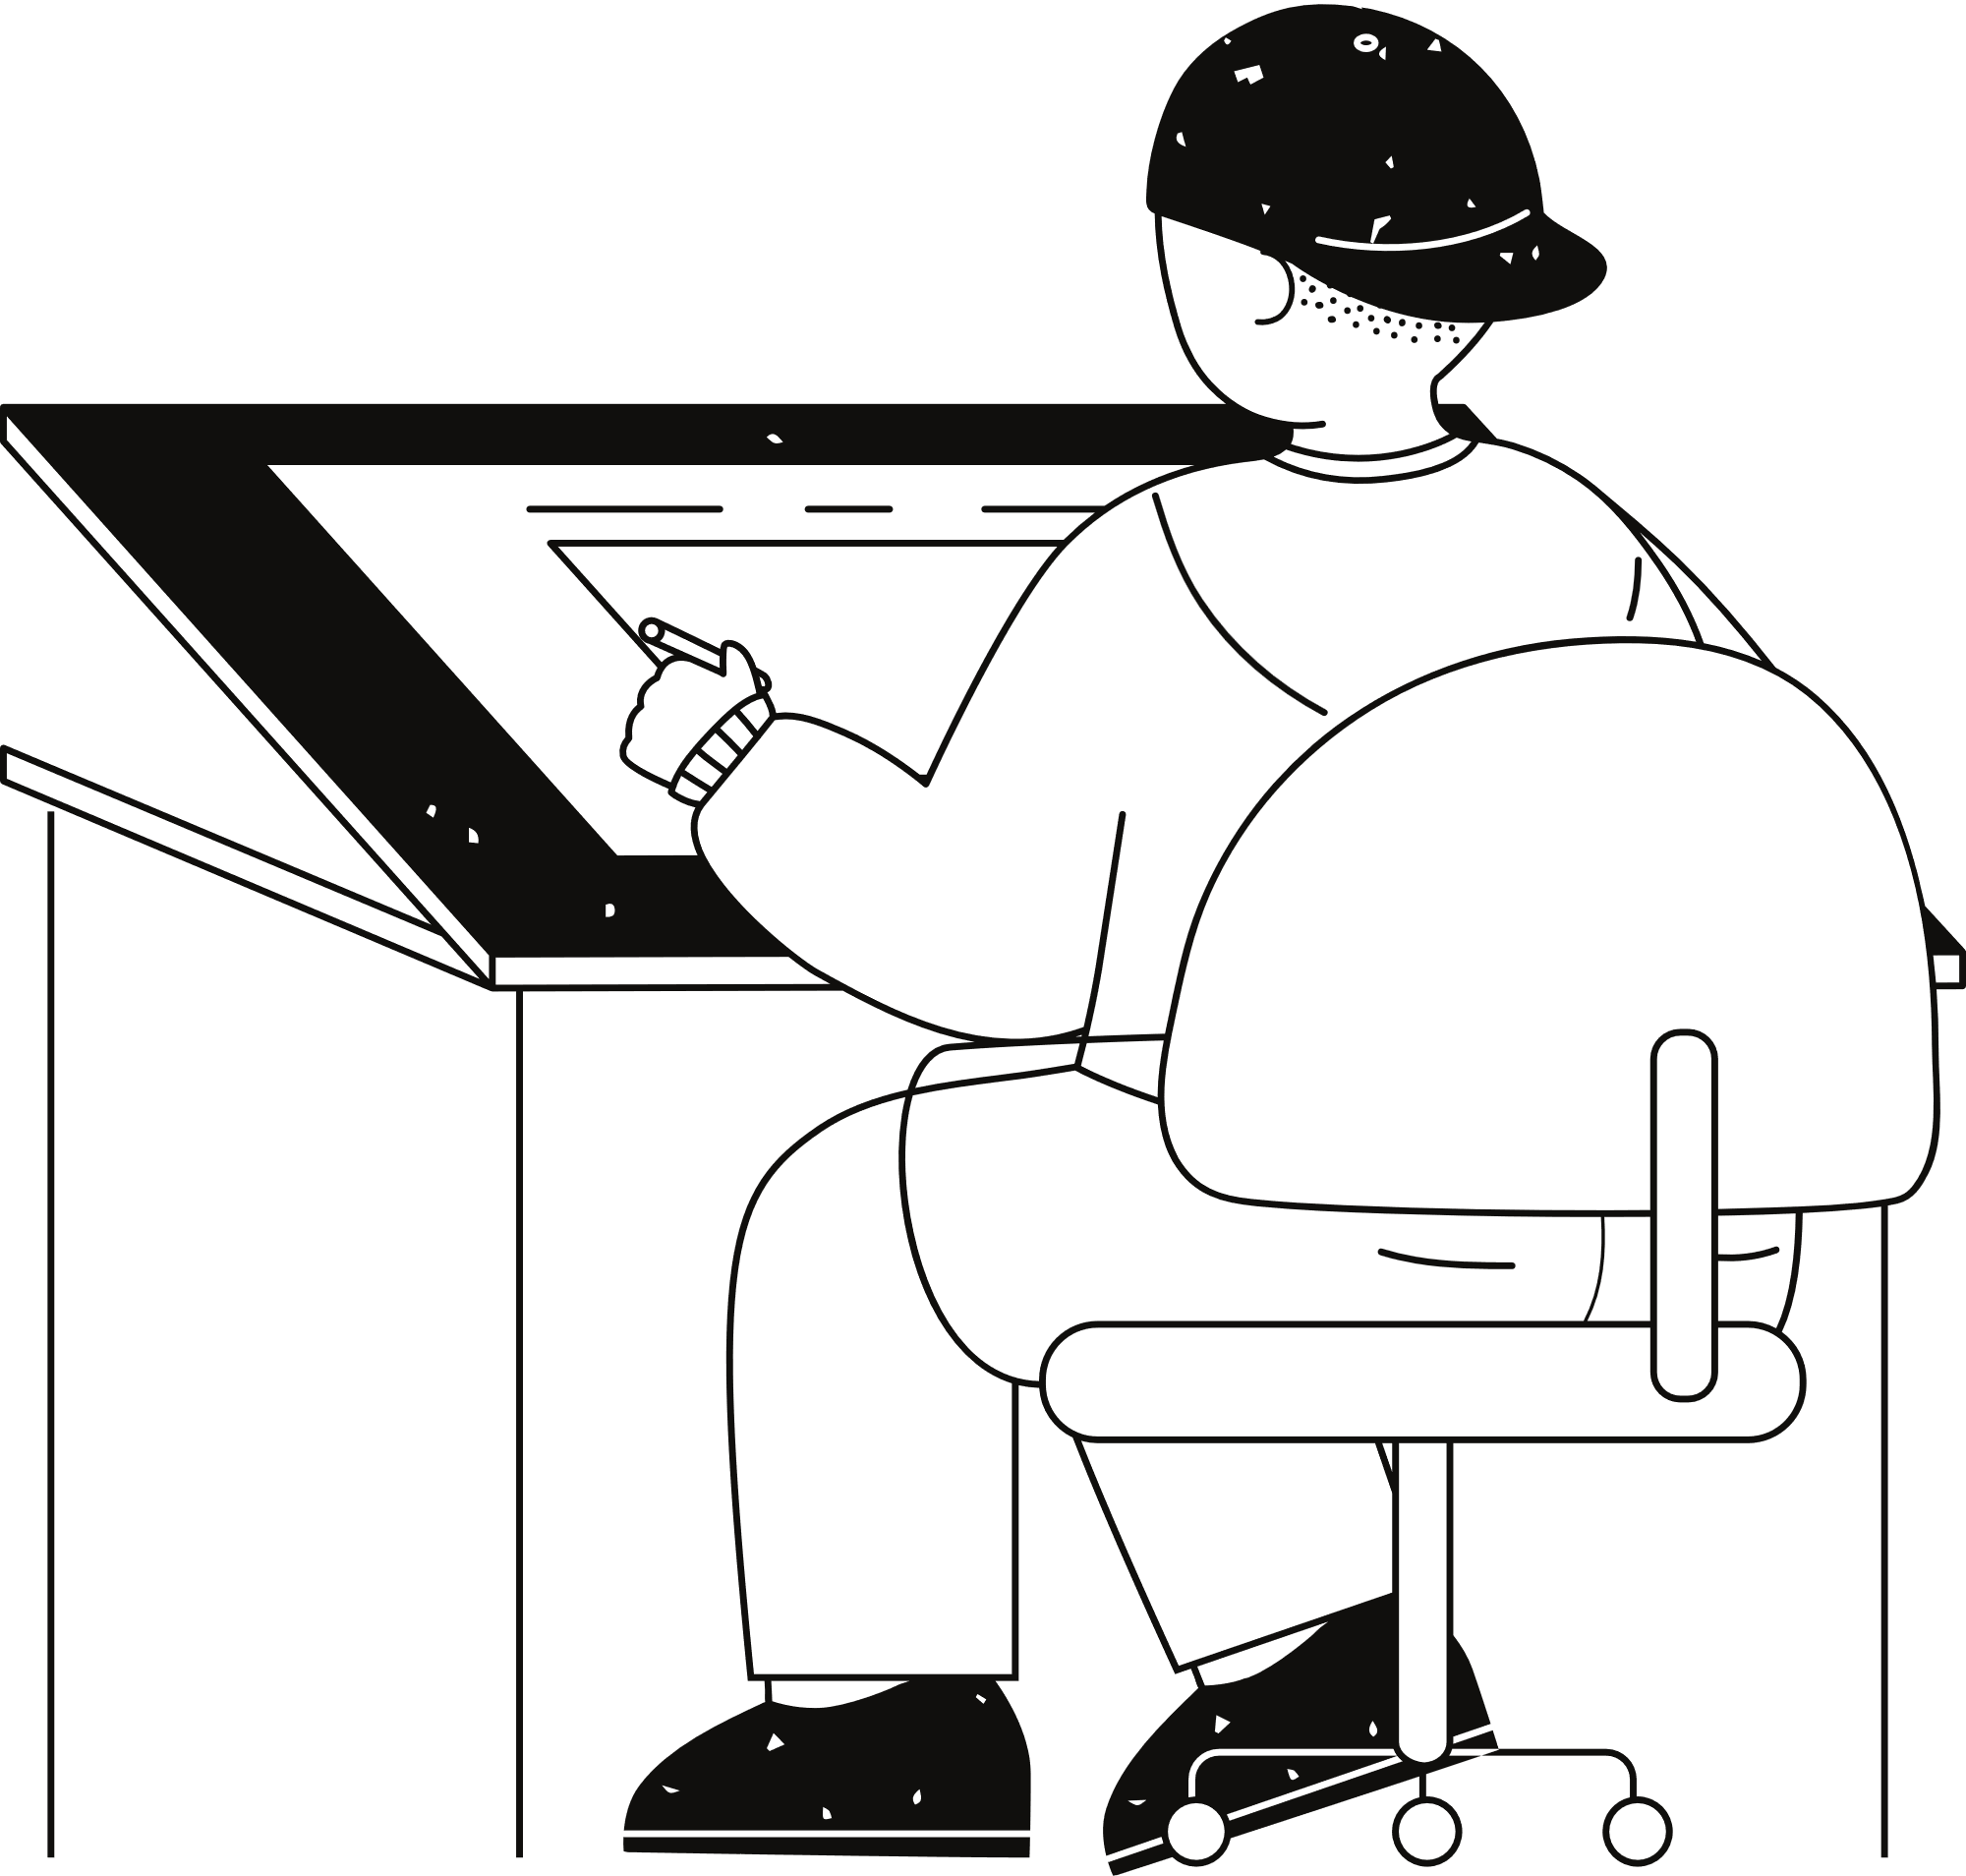


Application Tools
Programming Language:
Python: The entire app logic and interface are built using Python, chosen for its versatility, readability, and rich library support.
Pycharm: Used for writing, organizing, and debugging the Python code with its rich extension support and interactive debugger.
Libraries/Packages
Pandas: To handle inventory and sales data as DataFrames and for data manipulation (e.g., reading, updating, saving CSV files).
Operating System:: For checking and creating files (used for inventory and sales file initialization).
tkinter: For creating a GUI interface with various widgets like buttons, labels, and entry fields.
Development Tools
PyCharm: For coding, debugging, and managing project files.
Visual Studio Code: An alternative IDE for quick editing and testing.

Slide 7



Project Design
It is a GUI application designed for managing inventory and sales data in a grocery store. It provides an easy-to-use interface that allows users to add, update, and delete products from the inventory, record sales, and generate reports. The application uses the Tkinter library for creating the graphical user interface and the pandas’ library for handling the data in CSV files. The GUI includes labels and entry fields for entering product details such as name, price, and quantity. Users can perform various tasks by clicking on the buttons provided, such as adding new products, updating existing ones, deleting products, selling products, displaying the inventory, and generating sales reports.
The application is a functional implementation of a grocery store inventory and sales management system, but it may require additional features and error handling depending on the specific needs of the grocery store. Overall, the project is an excellent example of how technology can be used to streamline operations and improve efficiency in retail businesses.

Slide 8
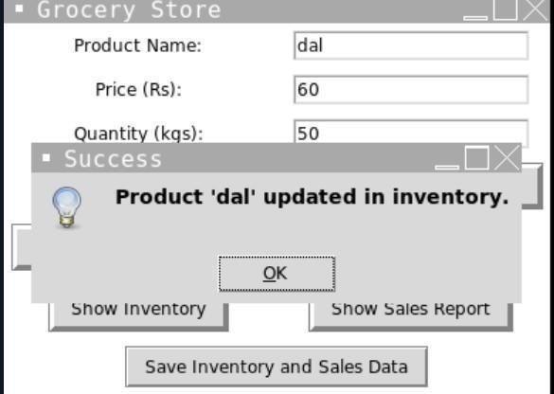
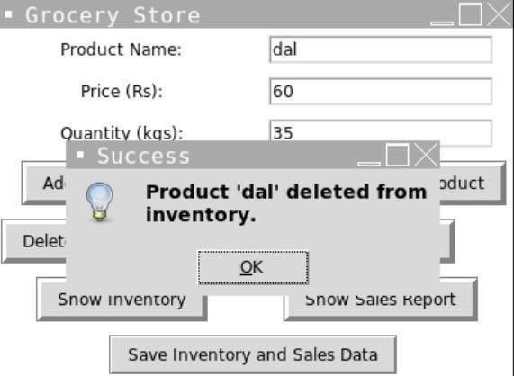
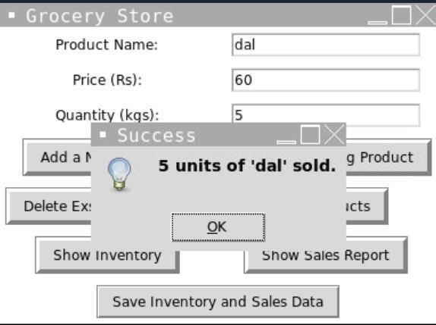
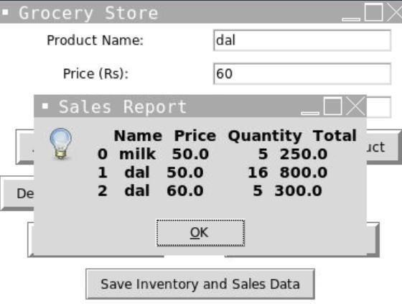

Slide 9
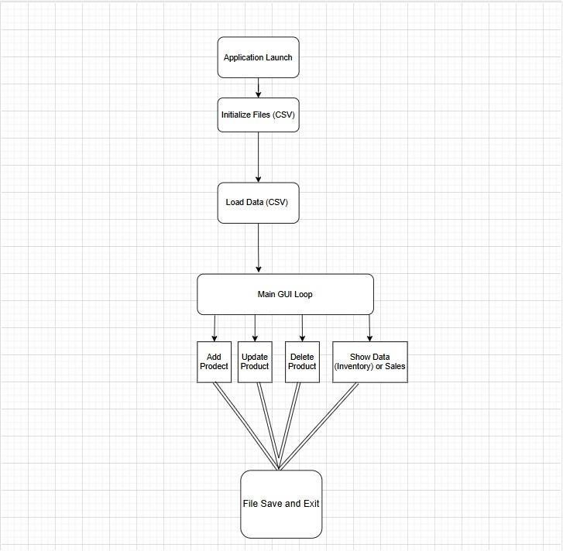
Flow Chart
Application Launch: The program starts execution and prepares for file and data initialization.
Initialize Files (CSV) : Check if inventory.csv and sales.csv exits. Creates them with Appropriate headers if missing
Load Data (CSV)
Reads data from the CSV files into inventory_df and sales_df pandas DataFrames.
Main GUI Loop
The Tkinter GUI allows user interactions through buttons.
Functionalities
Add Product: Adds a new product to inventory.
Update Product: Updates price and quantity of an existing product.
Delete Product: Removes a product from inventory.
Show Data: Displays inventory or sales data in a message box.
File Save and Exit o Saves updated inventory and sales data to their respective CSV files and closes the application.

Slide 10
Testing and validation
Unit Testing
Purpose: Ensures individual components of the system, such as inventory and sales modules, function as expected.
Focus: Validates isolated functionality, including adding, updating, displaying, and deleting inventory items.
Scenarios: Includes validation of file saving operations (inventory.csv and sales.csv) and handling user inputs like product details.
Success Criteria: Checks accurate updates to inventory, proper error handling for invalid inputs, and successful file operations.
Outcome: Each unit test passed, confirming the correctness of individual components.
System Testing
1. Purpose: Ensures proper behavior when multiple modules interact, such as file handling, inventory management, and sales processing.
Scope: Covers both functional (e.g., data updates) and non-functional (e.g., responsiveness under high load) requirements.
Scenarios: Includes testing file initialization, concurrent operations, GUI interactions, and sales reporting accuracy.
Success Metrics: Validates that actual outcomes match expected outcomes without crashes or errors.
Outcome: All system tests passed, confirming seamless integration and reliability of the application.

Slide 11
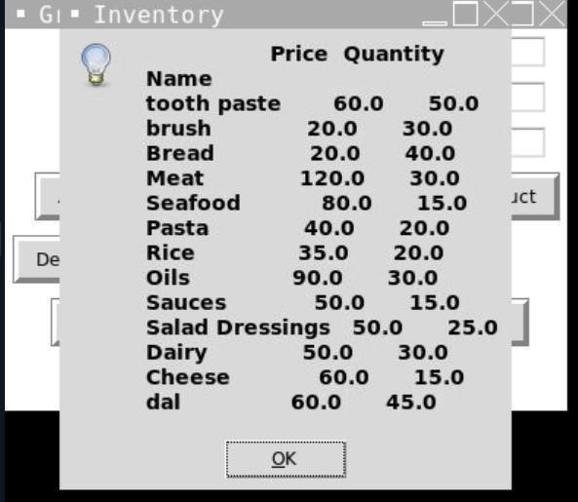
Conclusion
It is a functional grocery store inventory and sales management system using Python. The system allows for the addition, updating, and deletion of products from the inventory, selling of products, and generating reports on the inventory and sales data. The graphical user interface (GUI) makes it easy for users to interact with the system by entering the details of products and performing various tasks with the click of a button. Overall, project is a good implementation of a grocery store inventory and sales management system, although additional features and error handling could be added to improve its functionality and usability.

Slide 12
Reference
Programming Documentation:
Python Official Documentation: Comprehensive guide for Python syntax, libraries, and modules.
https://docs.python.org/3/
Tkinter Documentation: Official documentation for Python's Tkinter library. https://docs.python.org/3/library/tkinter.html
External Libraries:
pandas: To handle inventory and sales data as DataFrames and for data manipulation (e.g., reading, updating, saving CSV files).
tkinter: For creating a GUI interface with various widgets like buttons, labels, and entry fields.
APIs and Online Tools:
API: Used to fetch Information on Project
Development and Debugging Tools:
GitHub: Repository for managing and sharing project code. https://github.com
Pycharm: Python's integrated development environment for coding and debugging.
Tutorials and Guides:
Real Python Tutorials: Articles and tutorials on Python and Tkinter. https://realpython.com _{o} Stack Overflow: Community support for resolving development issues.
https://stackoverflow.com
University Resources:
Lovely Professional University: Provided educational materials and tutorials related to programming and project development.
Books and Study Material:
"Python Crash Course" by Eric Matthes: A beginner-friendly guide to Python programming. "Python GUI Programming with Tkinter" by Alan D. Moore: Insights into designing graphical applications.
Miscellaneous Resources:
YouTube tutorials for Python, Tkinter, and integration of external libraries.

Slide 13
Thank you very much!

